Slide 1


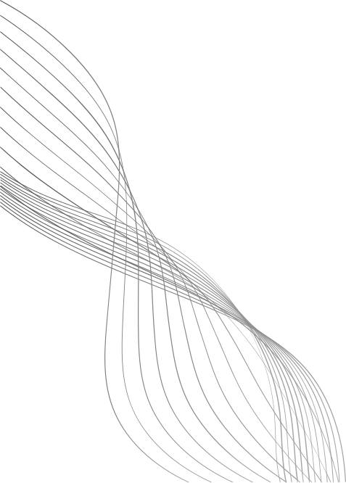
PREFERENTIAL
ATTACHMENT
MODEL
By-RITIK THAKUR
Roll No. 205124079

Slide 2
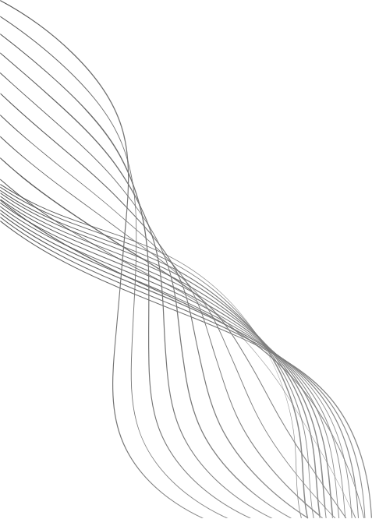
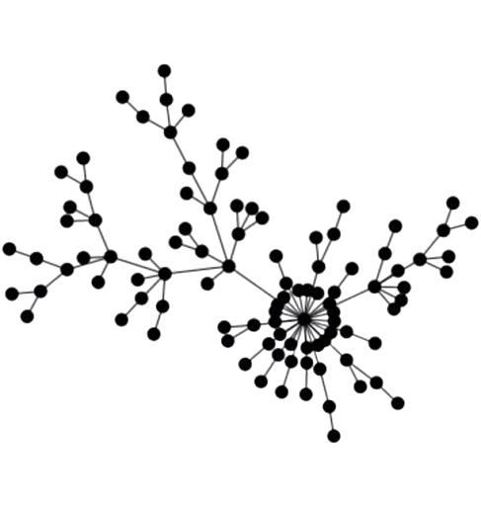
INTRODUCTION
The Preferential Attachment Model explains how networks grow over time in such a way that popular nodes get even more connections.
It is often summarized as: “The rich get richer”
This model is widely used to describe social networks, the internet, citation networks, and many real-world systems.
02

Slide 3
CORE IDEA
Nodes = entities (people, websites, papers, etc.)
Edges = connections (friendships, hyperlinks, citations, etc.)
In this model:
New nodes prefer to connect to existing nodes that are already popular (nodes with high degree).
Over time, a few nodes become hubs (very highly connected), while most nodes have few connections.
03

Slide 4
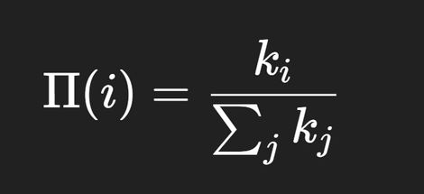
HOW IT WORKS
Step 1 — Start with a Small Network
Begin with a small network of m₀ nodes, all connected somehow.
Step 2 — Add a New Node
A new node joins the network.
Step 3 — Connect to Existing Nodes
The new node creates m edges to existing nodes.
Probability of connecting to node i:
where:
ki = degree of node i
∑j kj = sum of degree of all nodes
Step 4 — Repeat
Keep adding new nodes one by one, each following the same rule.
The network grows over time, forming hubs naturally.
04

Slide 5
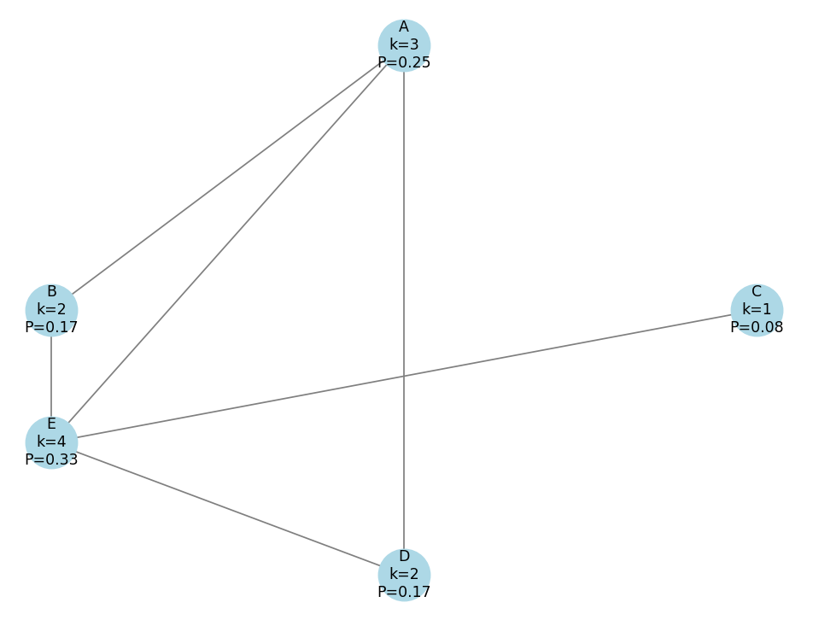
EXAMPLE
We start with N=5 nodes, A through E , for simplicity in PA model we ‘ll assume the initial connections are already established(as in graph)
NODE: A B C D E
DEG : 3 2 1 2 4
PI = KI /12
Prob : 0.25 0.17 0.08 0.17 0.33
05

Slide 6
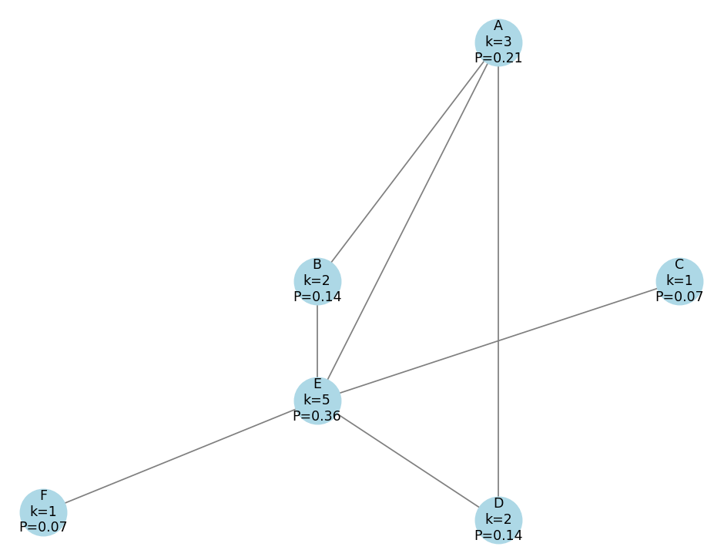
EXAMPLE
A new node, F, is added and establishes m=1 connection. We now recalculate the probabilities based on the new degrees.
NODE: A B C D E F
DEG : 3 2 1 2 5 1
PI = KI /13
Prob : 0.21 0.14 0.07 0.14 0.36 0.07
06

Slide 7
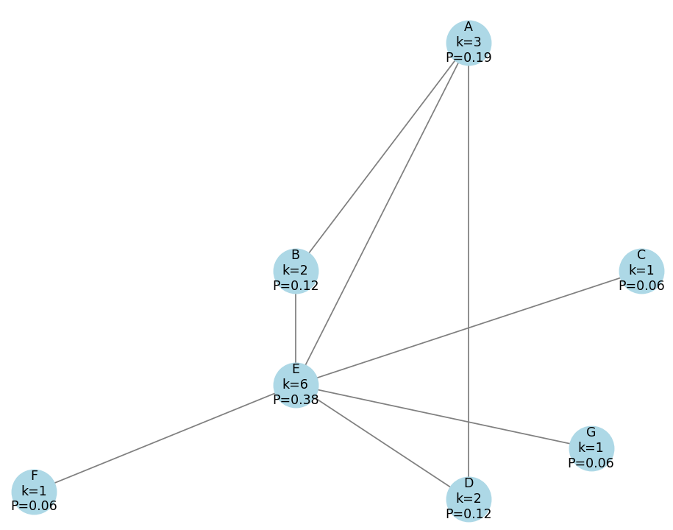
EXAMPLE
A new node, G, is added and establishes m=1 connection. We now recalculate the probabilities based on the new degrees.
NODE: A B C D E F G
DEG : 3 2 1 2 6 1 1
PI = KI /14
Prob : 0.19 0.12 0.06 0.13 0.38 0.06 0.06
07

Slide 8
APPLICATIONS
1. Social Networks
Explains how popular users (with many friends/followers) tend to attract more friends/followers.
Helps model growth of platforms like Facebook, Twitter, Instagram, where “the rich get richer.”
2. World Wide Web (WWW)
Models how new web pages link to popular, already well-linked websites.
Explains the scale-free nature of the web graph, where a few websites have many links and most have few.
3. Citation Networks
In academic research, papers that are already highly cited are more likely to be cited again.
Helps understand how knowledge and influence spread through scientific literature.
08

Slide 9
APPLICATIONS
4. Biological Networks
Used in modeling protein-protein interaction networks or neural networks where certain nodes become hubs over time.
Helps understand how complex biological systems evolve.
5. Economic Networks
Explains how certain companies or individuals become highly influential or central in trade or financial networks.
Helps in modeling wealth distribution or market dynamics.
6. Information Spread
Used to model how information or memes spread in online platforms, where viral content attracts more attention and shares.
09

Slide 10
THANK YOU

